Slide 1
Sean Koppenhafer, Jaime Rodriguez,
Chad Thueson, Noah Erickson, Rishal Dass
Weekly meeting, 3/04/2015 (Week 9)
Digital Dash
Portland State University
Department of Electrical and Computer Engineering (ECE)
Notes:
1

Slide 2
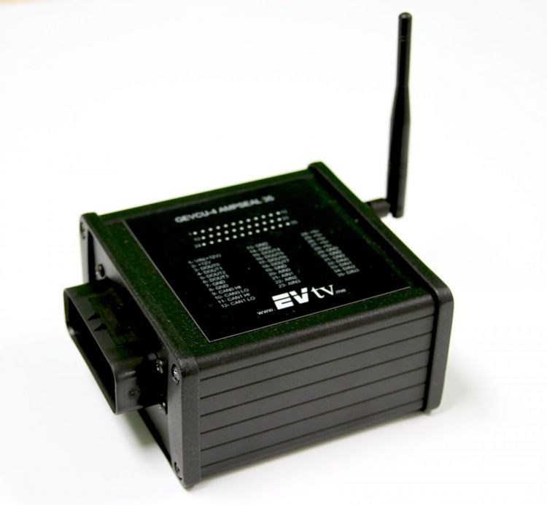
CAN Updates
Completed
Problems
RMS messages received
RMS messages output to display – temperature
BMS messages not being received
Oscilloscope shows noise on BMS
RMS temperature reading is small
Solutions
Emailed Michal about RMS temperature, how to get into the GEVCU
Also asked about BMS messages

Slide 3
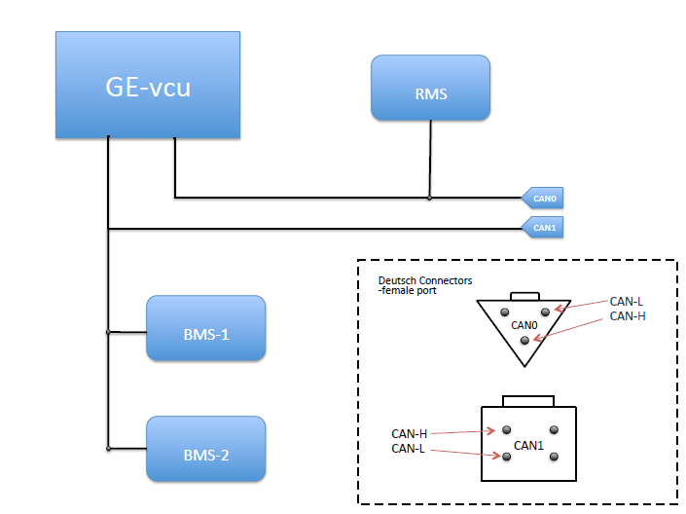
Wiring Harnesses
Diagram
Harness for RMS Still working (CAN0)
T-Splitter wiring harness recreated for BMS, 59.6 Ohms (CAN1)
Both of these are in the prototype stage and need more weatherproofing for final implementation

Slide 4
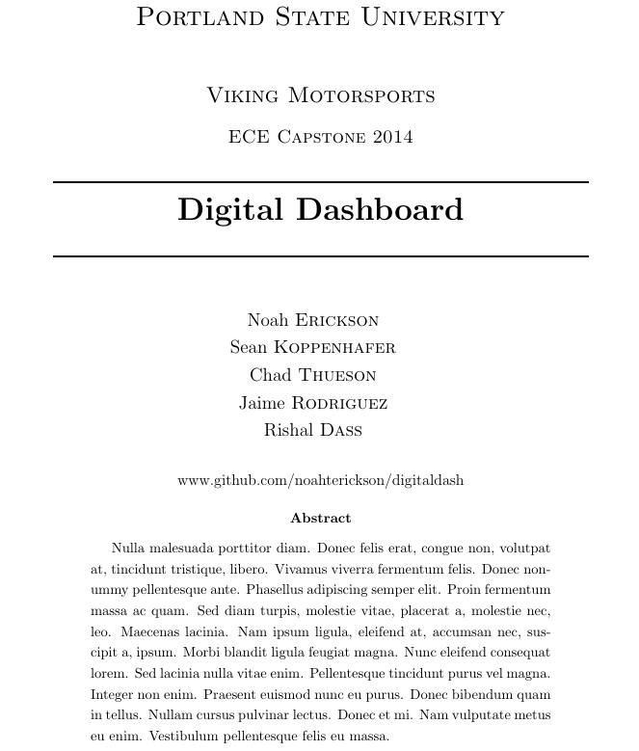
Documentation Updates
Software page updated on Github wiki
Roadblocks and Tools pages added to the wiki
Final report outline started and on repo (in latex)
Project is still on schedule

Slide 5
Goals for upcoming week
CAN
Connect to the GEVCU to verify messages using Michal’s instructions
Connecting to the GEVCU should also give us BMS messages
Enclosure
Start working on enclosure layouts
Check to see if other screen location is possible
Documentation
Continue work on the wiki, Michal requested our Bios and current roles
Continue work on the report outline

